Slide 1

Integration of I 4.0 standards
Alina Arunova, Maxim Maltsev, Philipp Matyash, Sattar Rahimbeyli
Tutor: Irlán Grangel

Slide 2

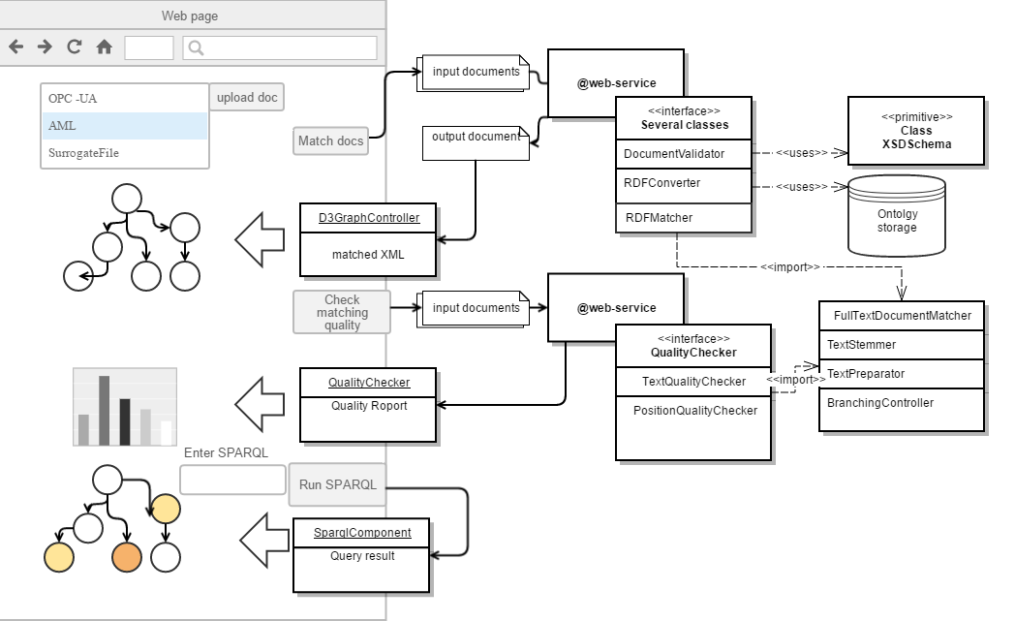
Architecture
2

Slide 3
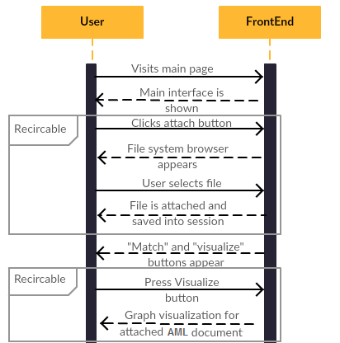
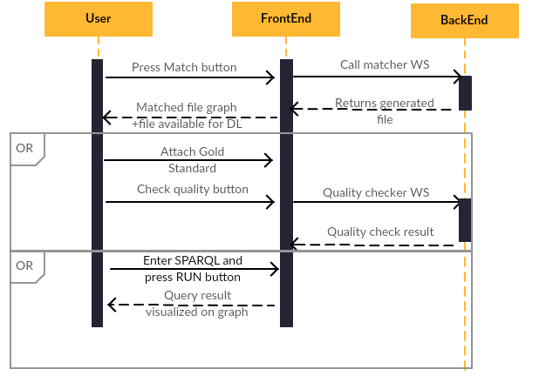
Sequence diagram
3

Slide 4
Workplan
Front end
01.06 – 01.07
Implementing the possibility of file uploading;
Visualizing the data (in XML format).
01.07 – 01.08
Implementing the possibility of browsing in the achieved result.
01.08 – 01.09
Testing of created tools;
Creating specifications and documents.
Back end
01.06 – 01.07
Development and realization of matching logic.
01.07 – 01.08
Development and realization of transport and security logics.
01.08 – 01.09
Testing of created tools;
Creating specifications and documents.
4

Slide 5
Integration of I 4.0 standards
Q&A?
5

